Slide 1
EDA On UFO Sightings
Jisna Hameed

Slide 2
UFO
An unidentified flying object (UFO), or unidentified anomalous phenomenon (UAP), is any perceived aerial phenomenon that cannot be immediately identified or explained. Upon investigation, most UFOs are identified as known objects or atmospheric phenomena, while a small number remain unexplained.

Slide 3
EDA
Exploratory Data Analysis (EDA)
Exploratory Data Analysis (EDA) refers to the method of studying and exploring record sets to apprehend their predominant traits, discover patterns, locate outliers, and identify relationships between variables. EDA is normally carried out as a preliminary step before undertaking extra formal statistical analyses or modeling.

Slide 4
The Foremost Goals of EDA
1. Data Cleaning
2. Descriptive Statistics
3. Data Visualization
4. Feature Engineering
5. Correlation and Relationships
6. Data Segmentation
7. Hypothesis Generation
8. Data Quality Assessment

Slide 5
Kaggle
UFO sightings data is obtained from kaggle
https://www.kaggle.com/datasets/NUFORC/ufo-sightings

Slide 6
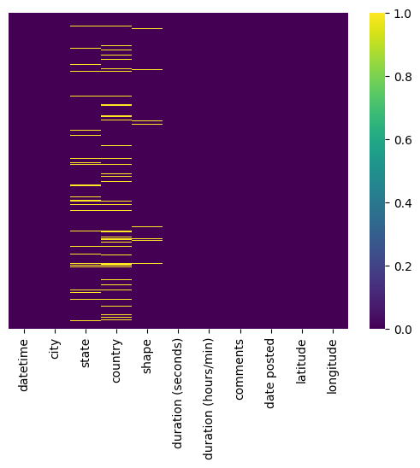
Heatmap - Showing missing
values

Slide 7
Identifying the Locations
Scatter Plot of Longitude vs lattitude

Slide 8
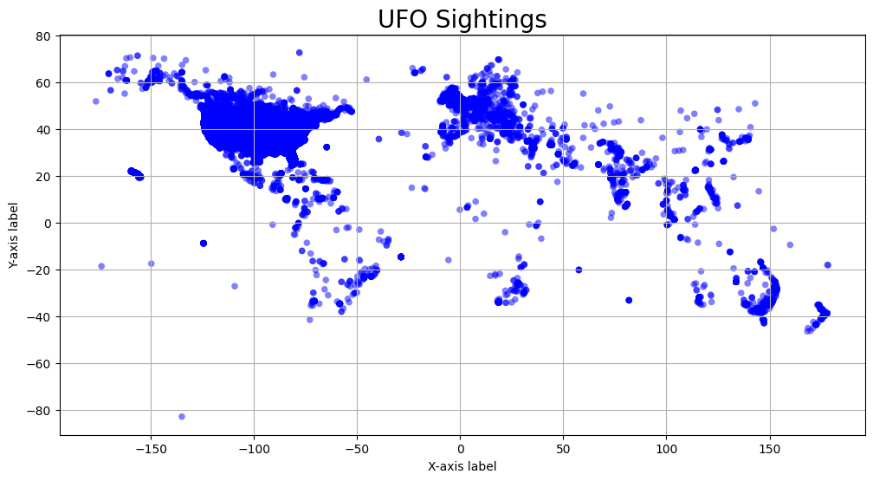

Slide 9
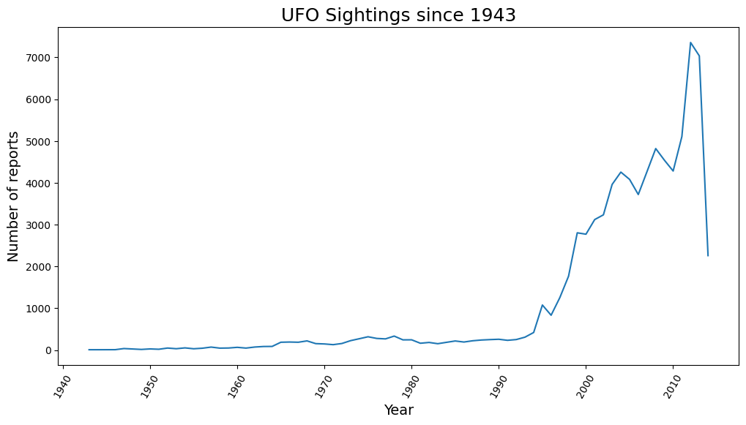
UFO sightings in Years

Slide 10
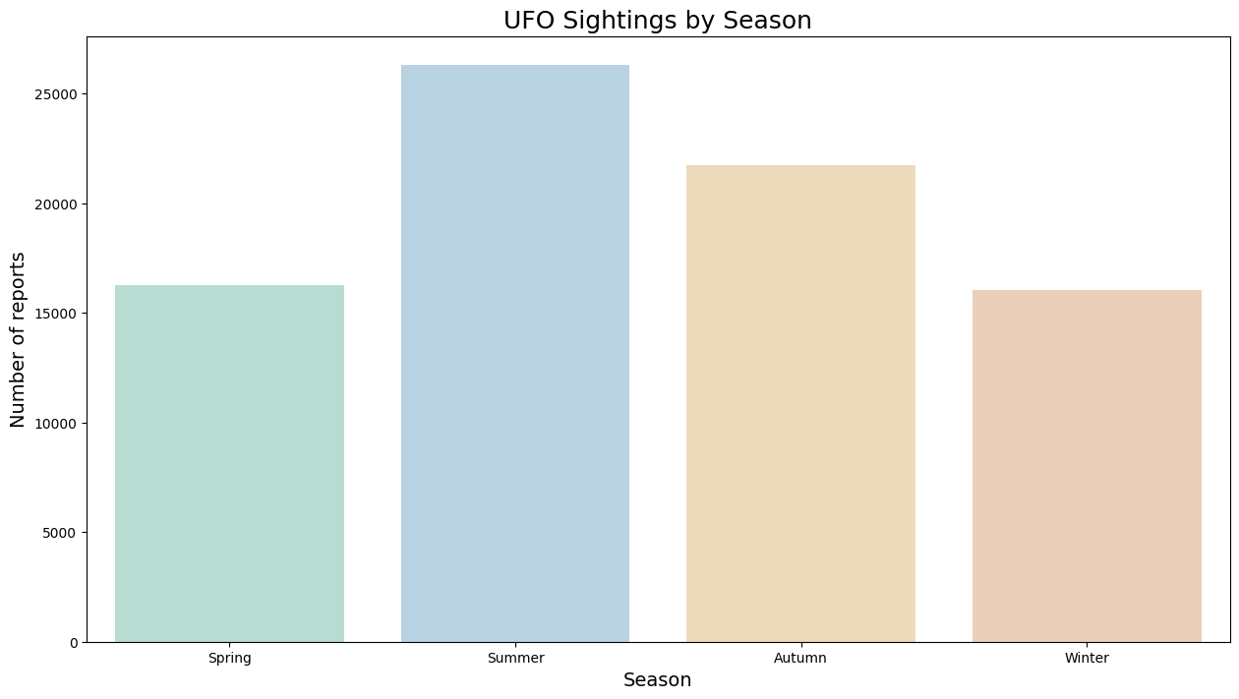
UFO sightings By Season

Slide 11
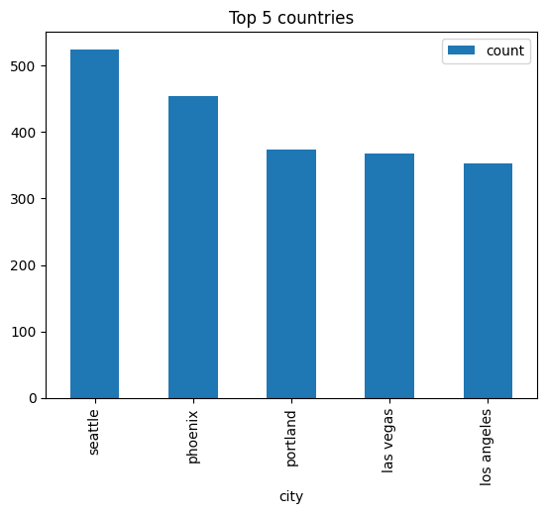
Top 5 countries UFO sighted

Slide 12
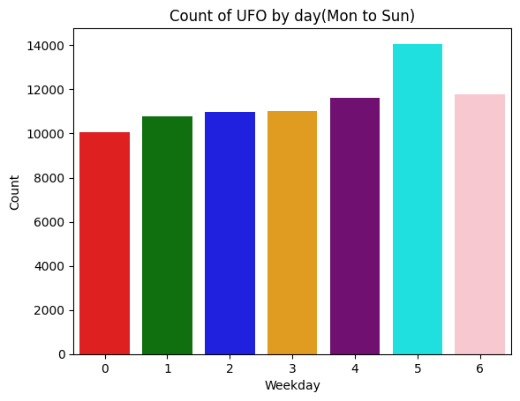
UFO sightings in different days

Slide 13
Thankyou

